Slide 1
When particles behave like waves
26PYB1002J · UNIT 3 · QUANTUM PHYSICS
Matter waves, the uncertainty principle, and the wave of probability: Lectures 3, 6 and 7

Slide 2

Three lectures, one story
THE ROAD MAP
LECTURE 6
LECTURE 7
LECTURE 3
Waves are spread out
The wave is probability
Matter has a wave
λ = h / p
Δx · Δp ≥ ħ/2
|ψ|² and proof
An electron is neither a tiny ball nor a water wave. It is a quantum object that shows wave behaviour in some experiments and particle behaviour in others.

Slide 3
Matter waves
03
If light can be a particle, can a particle be a wave?

Slide 4
Light already plays both roles
LECTURE 3 · MATTER WAVES
As a wave
As a particle
Interference and diffraction: light spreads, overlaps and cancels.
Photoelectric and Compton effects: light arrives in packets (photons).
1924 · LOUIS DE BROGLIE
Nature loves symmetry, so matter should be dual too. The waves of moving particles are called matter waves.

Slide 5
From light to matter in three steps
LECTURE 3 · MATTER WAVES
STEP 1
STEP 2
STEP 3 · THE LEAP
One photon, two descriptions
Equate, and use c = νλ
Apply it to every particle
p = hν / c
p = h / λ
λ = h / p
λ = h / mv
E = hν
E = pc
Watch the symbols: ν (nu) is frequency, v is velocity.

Slide 6
Why doesn't a cricket ball diffract?
LECTURE 3 · MATTER WAVES
Object | Mass, speed | λ = h / mv | Compared with
Cricket ball | 0.16 kg, 42.83 m/s | ≈ 1 × 10⁻³⁴ m | 10²⁰ times smaller than a nucleus: invisible
Electron | 9.11 × 10⁻³¹ kg, 10⁶ m/s | 7.3 × 10⁻¹⁰ m | about the spacing of atoms: observable
Wave effects show up only when λ is comparable to the size of what the wave meets.

Slide 7
One formula, four disguises
LECTURE 3 · MATTER WAVES
The trick every time: p² = 2m × (kinetic energy), then λ = h / p.
From momentum
From kinetic energy E
λ = h / mv
λ = h / √(2mE)
From voltage V (KE = eV)
From temperature T (KE = 3/2 kT)
λ = h / √(2meV)
λ = h / √(3mkT)

Slide 8
The number to remember
LECTURE 3 · FOR ELECTRONS ONLY
Example: V = 54 volts
Put h, m and e of the electron into h / √(2meV):
λ = 12.27 / 7.35
λ = 12.27 / √V Å
≈ 1.67 Å
V in volts · 1 Å = 10⁻¹⁰ m
Keep this number. In Lecture 7, an experiment at exactly 54 V measures 1.65 Å.

Slide 9
Three quick questions
LECTURE 3 · CHECK YOUR UNDERSTANDING
A proton and an electron move at the same speed. Which has the longer de Broglie wavelength?
You double an electron's accelerating voltage. What happens to λ?
Neutrons have no charge. Why can they still be diffracted by a crystal?

Slide 10
The uncertainty principle
06
If a particle is a wave, where exactly is it?

Slide 11
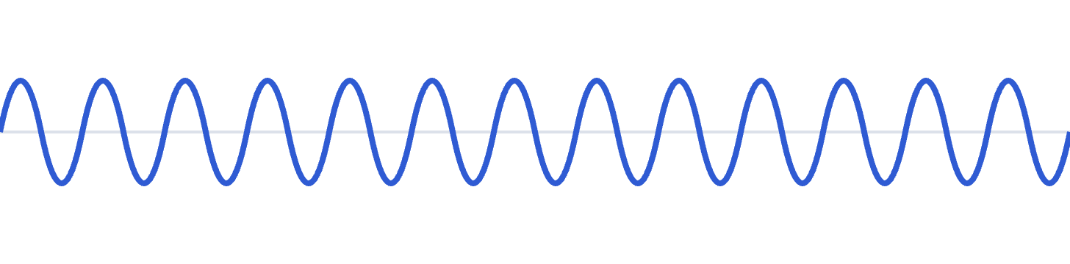

Sharp wavelength or sharp position: never both
LECTURE 6 · UNCERTAINTY
A long, regular wave
A short wave packet
λ is clear, so p = h/λ is known. But where is the particle? Anywhere along it.
Position is clear. But a short burst mixes many wavelengths, so p is spread out.
This is not a flaw in our instruments. It is built into being a wave.

Slide 12
Heisenberg's uncertainty principle
LECTURE 6 · UNCERTAINTY
Δx · Δp ≥ ħ/2 where ħ = h/2π
Position and momentum
Energy and time: ΔE · Δt ≥ ħ/2
Squeeze Δx and Δp must grow. Halve Δx and the minimum Δp doubles.
A state that lasts a short time has a fuzzy energy, so spectral lines have a natural width.
Books write ≥ h, ≥ ħ or ≥ ħ/2. The exact limit is ħ/2; for quick estimates we use Δx · Δp ≈ ħ.

Slide 13
Why you never notice it
LECTURE 6 · UNCERTAINTY
A 1 g bead, located to 1 μm
An electron, located to 1 Å
Δv ≈ 10⁻²⁵ m/s
Δv ≈ 10⁶ m/s
Completely unnoticeable
Over 1,000 km every second
h is tiny, so uncertainty only matters for tiny things.

Slide 14
Can an electron live inside the nucleus?
LECTURE 6 · APPLICATION
Step | Result
1. Confine it to the nucleus (diameter) | Δx ≈ 2 × 10⁻¹⁴ m
2. Uncertainty estimate: Δp ≈ h / (2πΔx) | Δp ≈ 5.27 × 10⁻²¹ kg m/s, so p ≈ Δp
3. Kinetic energy: K = p² / 2m | K ≈ 1.52 × 10⁻¹¹ J ≈ 96 MeV
4. Compare with β-decay electrons | only about 4 MeV observed
Energy needed (96 MeV) is about 24× more than observed (4 MeV), so electrons cannot exist inside the nucleus.

Slide 15
They are created at the moment of decay.
SO WHERE DO Β-DECAY ELECTRONS COME FROM?
n → p + e⁻ + ν̄
A neutron turns into a proton, an electron and an antineutrino. The electron never lived inside the nucleus.

Slide 16
Three quick questions
LECTURE 6 · CHECK YOUR UNDERSTANDING
You halve Δx. What happens to the minimum Δp?
Would a perfect instrument beat the uncertainty principle? Why or why not?
An excited state lasts 10⁻⁸ s. Can its energy be perfectly sharp?

Slide 17
The wave function and its proof
07
What is actually waving, and how do we know electrons are waves?

Slide 18

What is waving? Probability.
LECTURE 7 · BORN INTERPRETATION (1926)
probability density = |ψ|² = ψ*ψ
Like a rain-chance map
It gives the odds at each place, not where each drop will land. |ψ|² is the electron's chance map.
ψ itself can't be measured. It may be negative or even complex.
Squaring it gives how likely the particle is to be found at each place.
Borrowed from light: intensity ∝ (amplitude)².

Slide 19
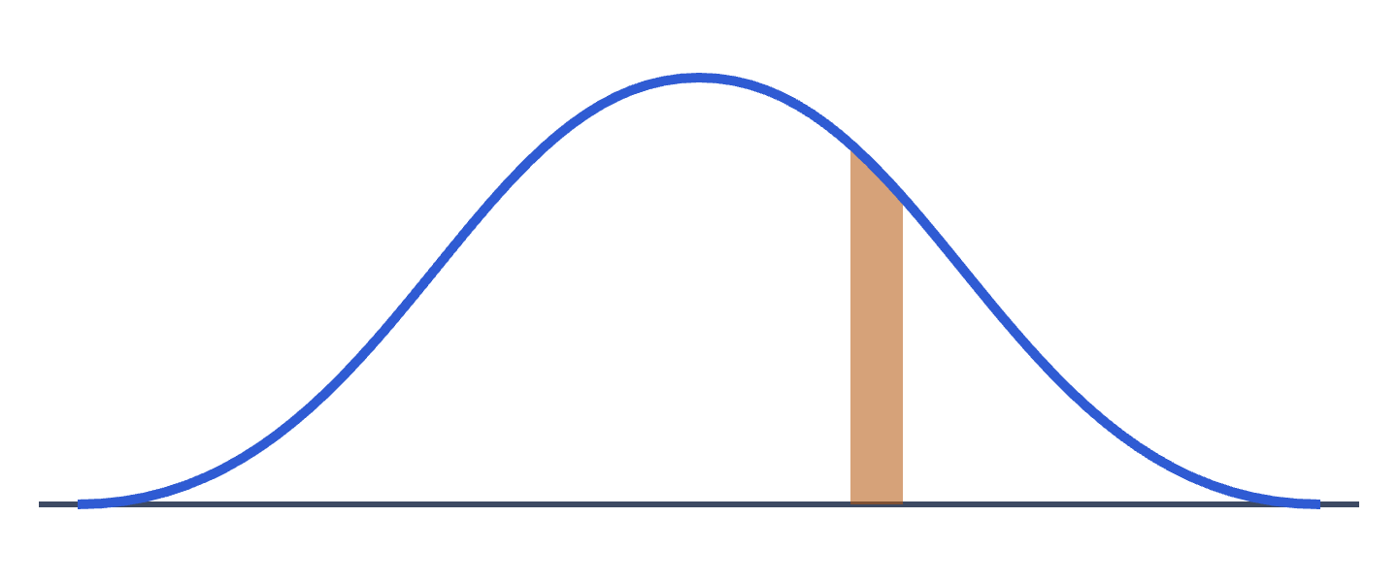
Probability is an area under |ψ|²
LECTURE 7 · BORN INTERPRETATION
P(x to x + dx) = |ψ(x)|² dx
High curve: likely. Zero: never.
Between a and b: the area, ∫ |ψ|² dx
At exactly one point? Zero. Always ask about an interval.
Blue curve: |ψ(x)|². Orange strip: width dx.

Slide 20
What makes ψ acceptable
LECTURE 7 · PHYSICAL SIGNIFICANCE OF Ψ
Single-valued
Continuous
One probability at each point in space and time.
No sudden jumps from one place to the next.
Finite
Normalised
Never infinite anywhere.
Total probability over all space is 1: ∭ |ψ|² dτ = 1
ψ is usually complex, so it can't be measured directly. Only |ψ|² can.

Slide 21
Choose A so the total is 1
LECTURE 7 · NORMALISATION
Example: ψ = A sin(πx/L) for 0 < x < L, zero elsewhere
Why ψ*ψ, not ψ²?
∫₀ᴸ A² sin²(πx/L) dx = 1
A² · L/2 = 1
A = √(2/L)
ψ may be complex. If ψ = a + ib, then
ψ*ψ = a² + b²
always real and never negative.

Slide 22
Verification of matter waves
LECTURE 7 · SECTION
de Broglie's idea was a hypothesis. Here's the experiment that proved it.
≈ 1.67 Å
Recall from Lecture 3: at 54 V
λ = 12.27 / √54
Notes:
Remind students: de Broglie's idea was a hypothesis; here's the experiment that proved it. Write λ ≈ 1.67 Å (at 54 V) in a corner of the board now, so you can point back to it when Davisson-Germer measures 1.65 Å.

Slide 23
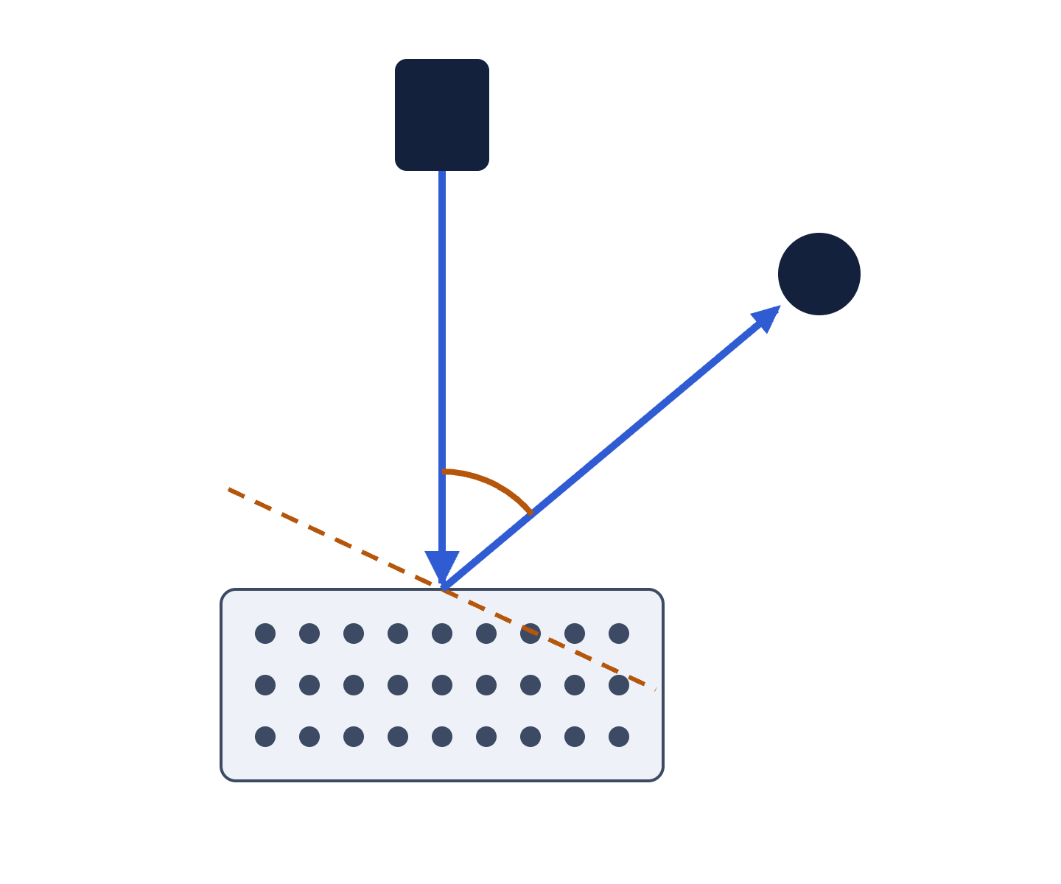
Firing electrons at a crystal
LECTURE 7 · DAVISSON–GERMER (1927)
Electron gun
V = 54 volts
Gun: a heated filament gives electrons; voltage V speeds them up and sets λ.
Nickel crystal: rows of atoms about 1 Å apart act as a grating.
Detector: rotates to measure how many electrons come off at each angle.
Result: a sharp peak at φ = 50° when V = 54 V.
Detector
Bragg planes
φ = 50°
Nickel crystal

Slide 24
Measured and predicted agree
LECTURE 7 · THE PUNCHLINE
Measured, with Bragg's law
Predicted, by de Broglie
2d sin θ = nλ
d = 0.91 Å, θ = 65°, n = 1
λ = 12.27 / √V Å
V = 54 V
1.65 Å
1.67 Å
θ = 65° because θ + 50° + θ = 180°: the Bragg planes split the angle between the beams.

Slide 25
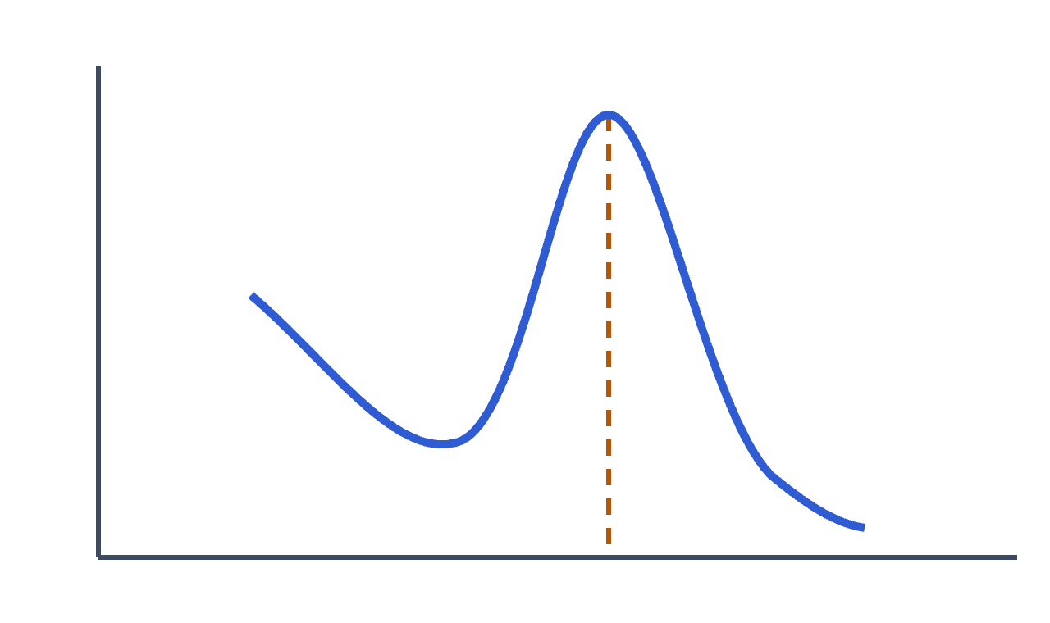
Why a peak proves waves
LECTURE 7 · DAVISSON–GERMER
Bouncing balls would give roughly the same count at every angle.
Observed: a sharp peak at 50°, the fingerprint of constructive interference.
Each electron lands as one dot (particle); the dots pile up where |ψ|² is large (wave).
J. J. Thomson (Nobel 1906): the electron is a particle. His son G. P. Thomson (Nobel 1937): it is a wave. Both were right.
Intensity vs angle at 54 V: peak at 50°

Slide 26
Three quick questions
LECTURE 7 · CHECK YOUR UNDERSTANDING
ψ = −0.3 at some point. Is that allowed? What is |ψ|² there?
Why must every wave function be normalised?
In Davisson–Germer, what happens to the 50° peak if V changes?

Slide 27
Unit 3 on one slide
WRAP-UP
Lecture | Big idea | Key formula
3 | Every moving particle has a wave | λ = h / p = h / √(2mE)
6 | A spread-out wave can't have sharp x and p | Δx · Δp ≥ ħ/2
7 | |ψ|² is probability, and electrons diffract | ∭ |ψ|² dτ = 1; 1.65 Å ≈ 1.67 Å
Particles travel like waves and arrive like particles.

